Slide 1
Elastic Net model results
Adam Shah

Slide 2
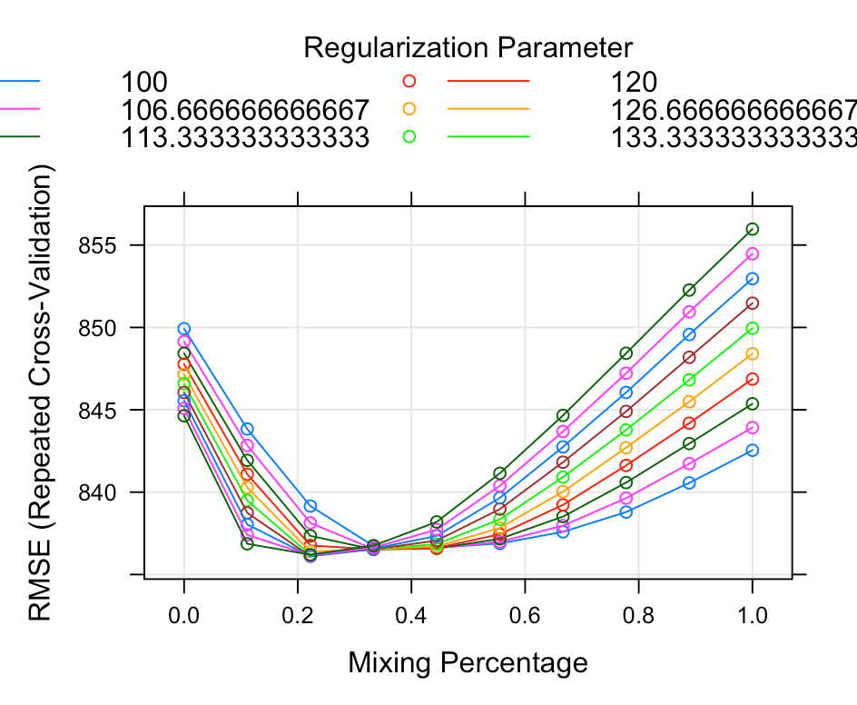
Only healthy-eyed people- choosing parameters
Parameters selected- alpha= 0.222, lambda = 120

Slide 3
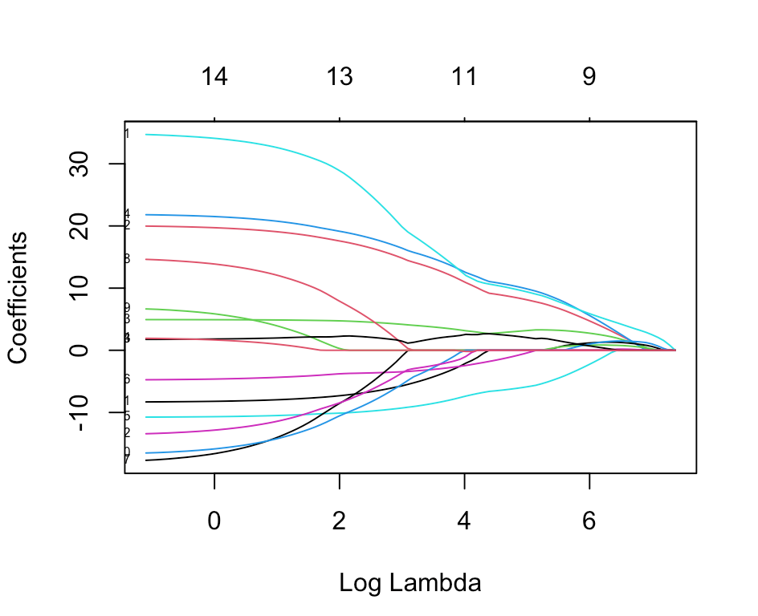
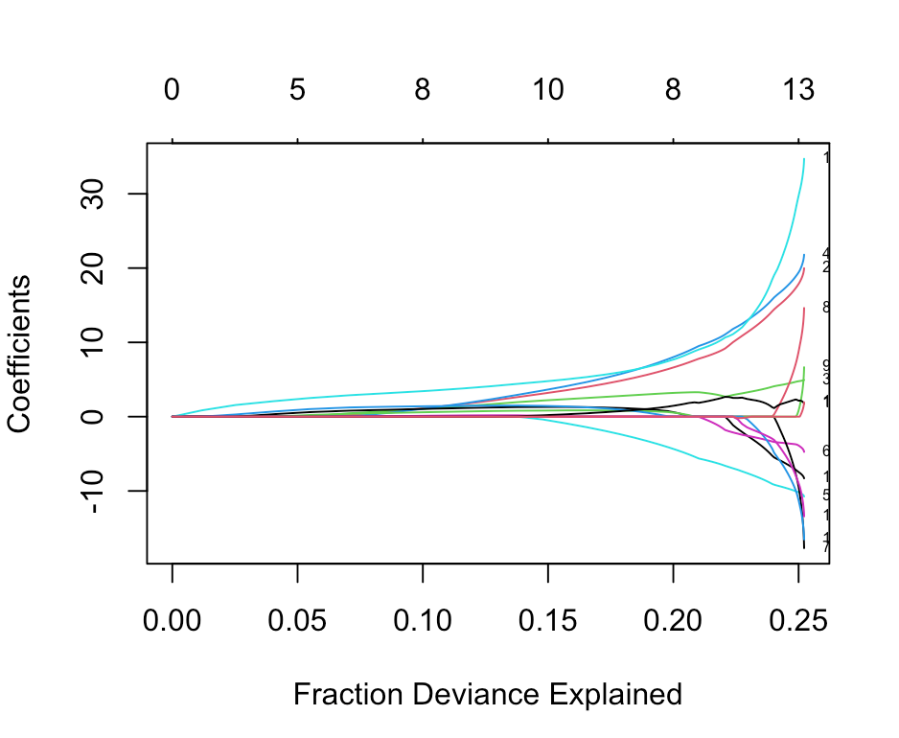
Determining number of variables included

Slide 4
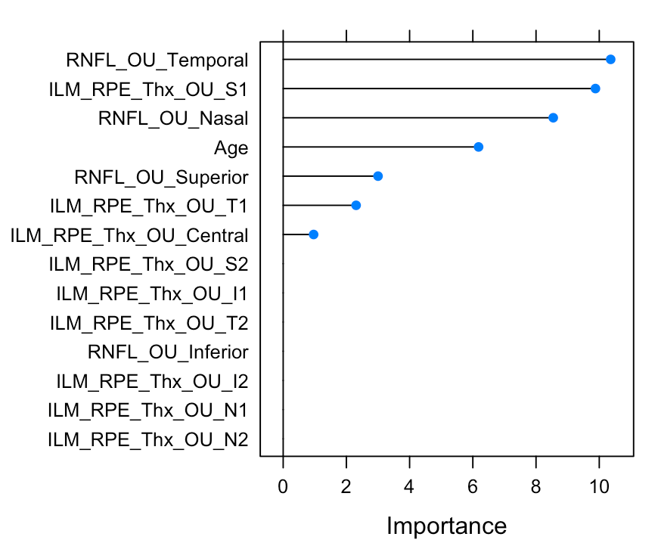
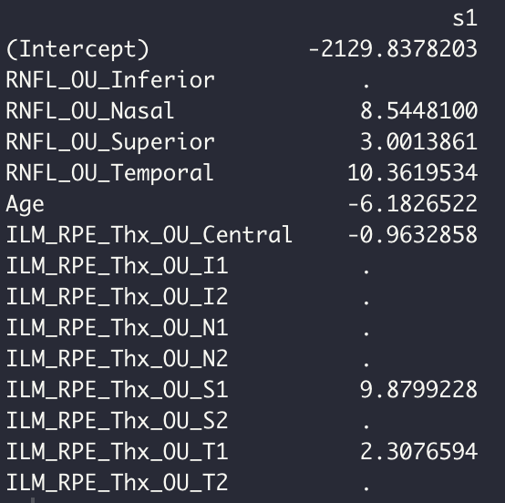
Most important variables and coefficients

Slide 5
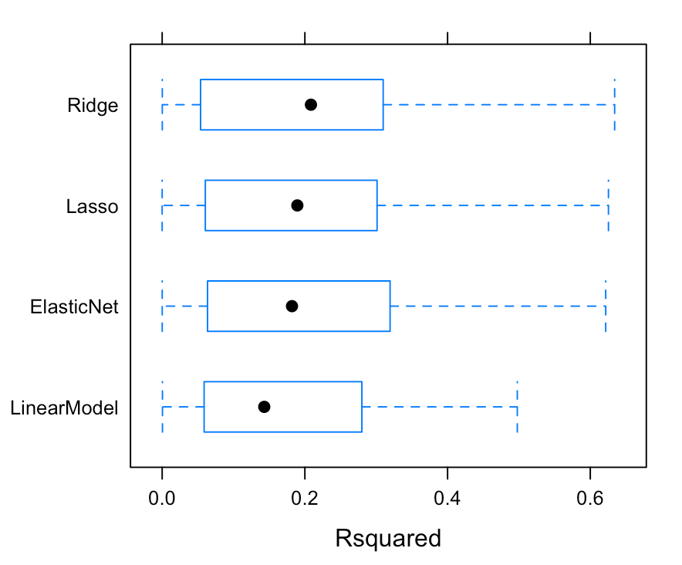
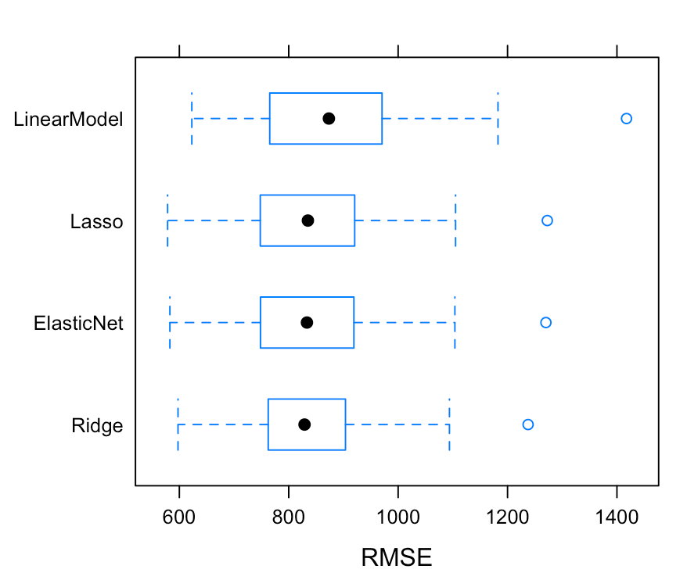
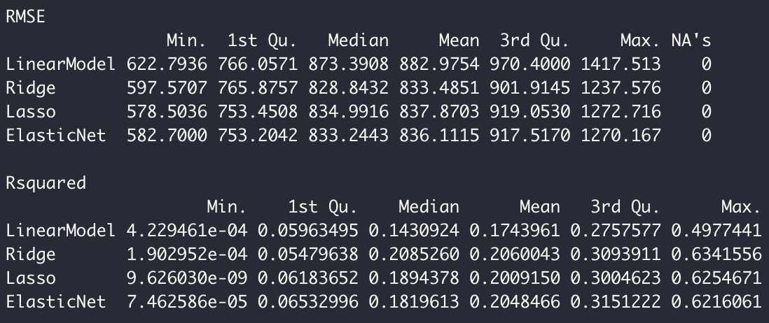
Comparison to Ridge and Lasso regression

Slide 6
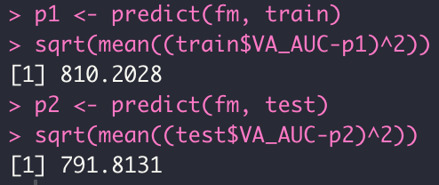
Fit for training and testing data
RMSE for training data
RMSE for testing data

Slide 7
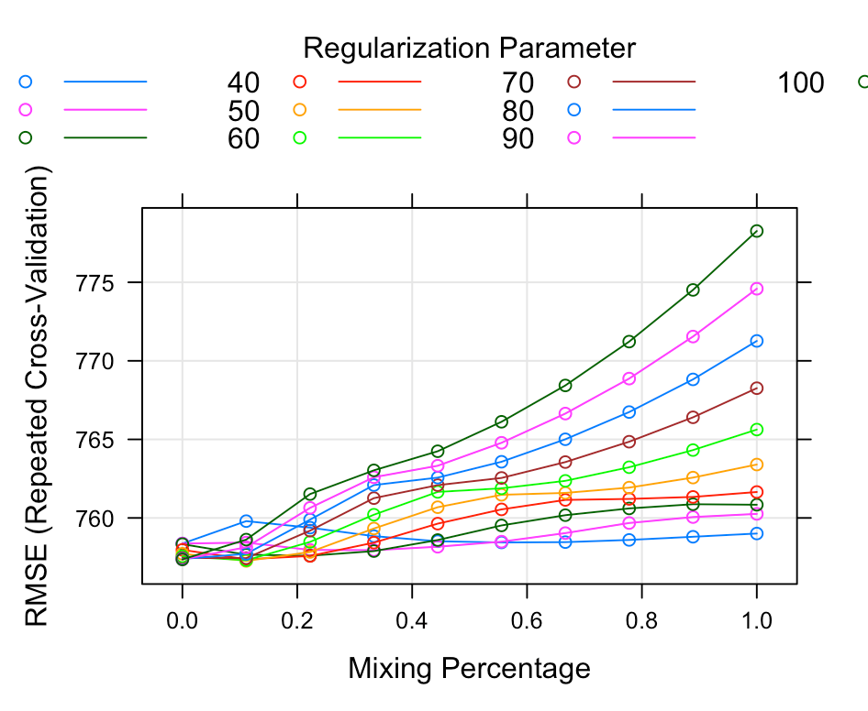
Whole dataset (including MS patients)- choosing parameters
Parameters selected- alpha = 0.1111 and lambda = 50

Slide 8
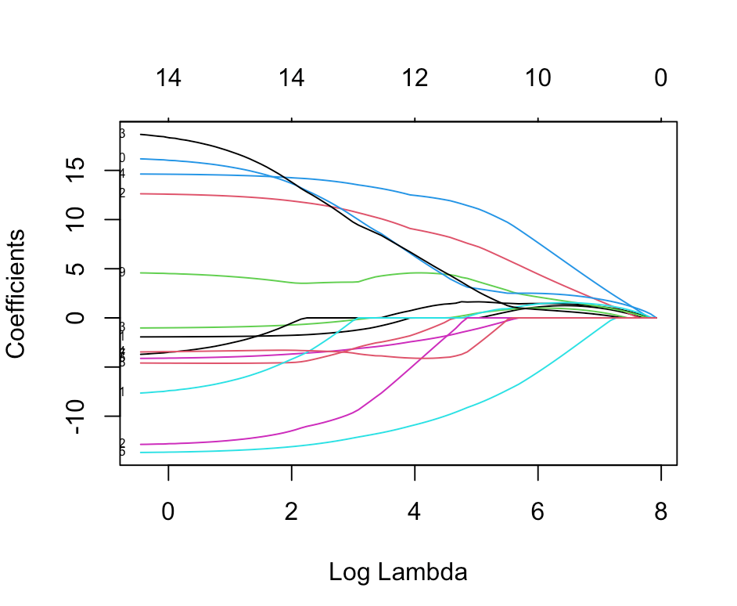
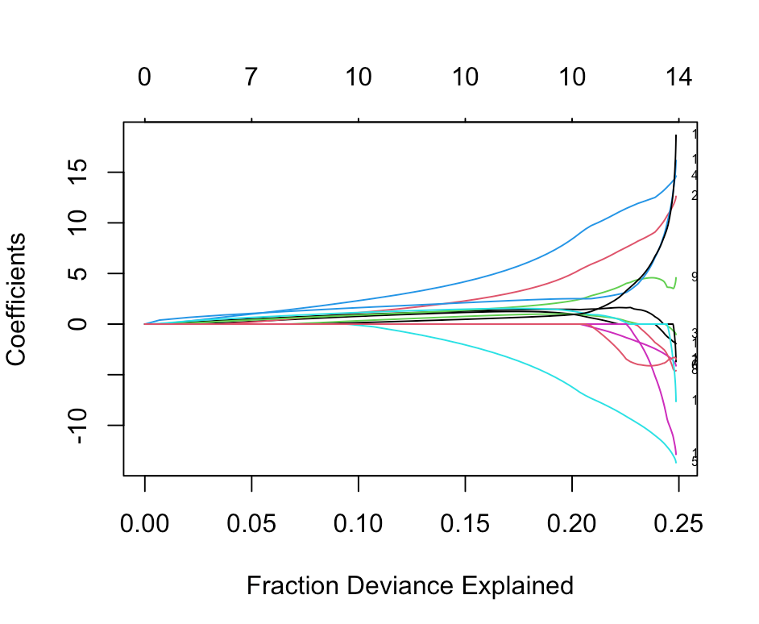
Determining number of variables included

Slide 9
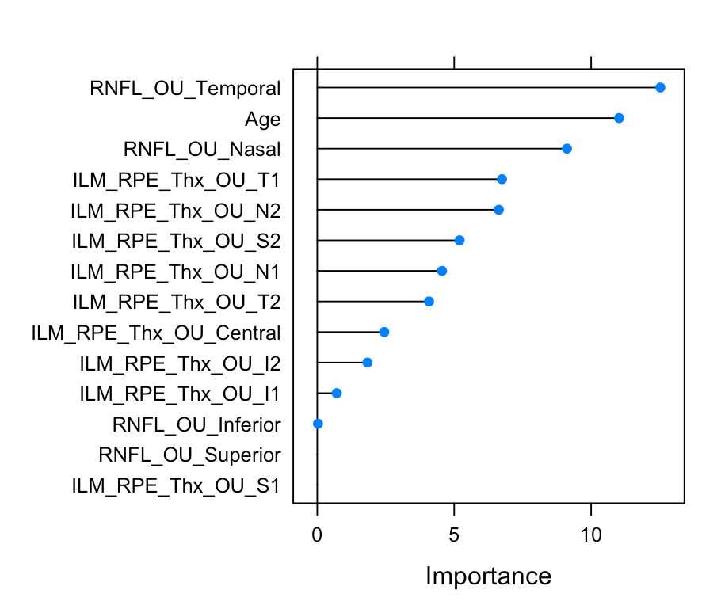
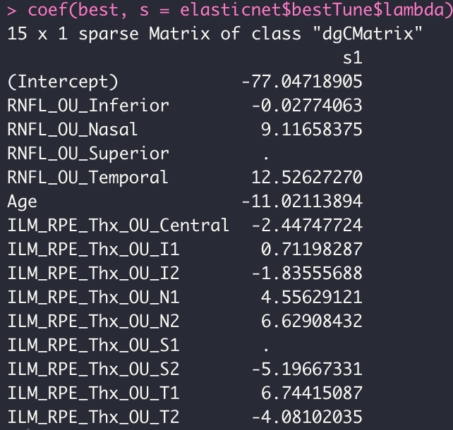
Most important variables and coefficients

Slide 10


Comparison to Ridge and Lasso regression
Elastic net seemed to
slightly outperform
other models in both
RMSE and R^2

Slide 11
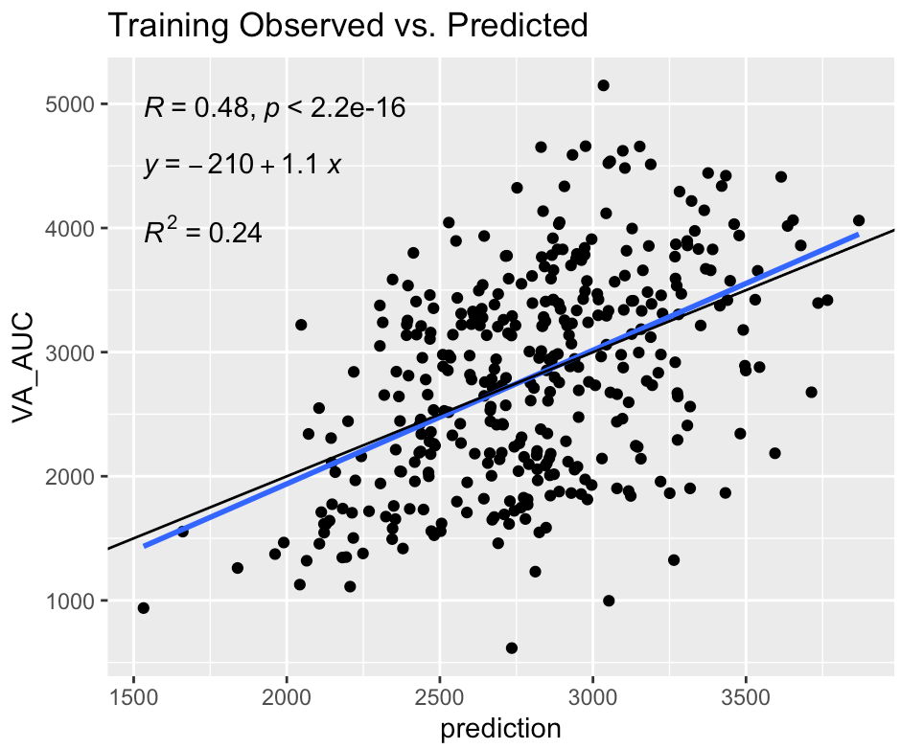
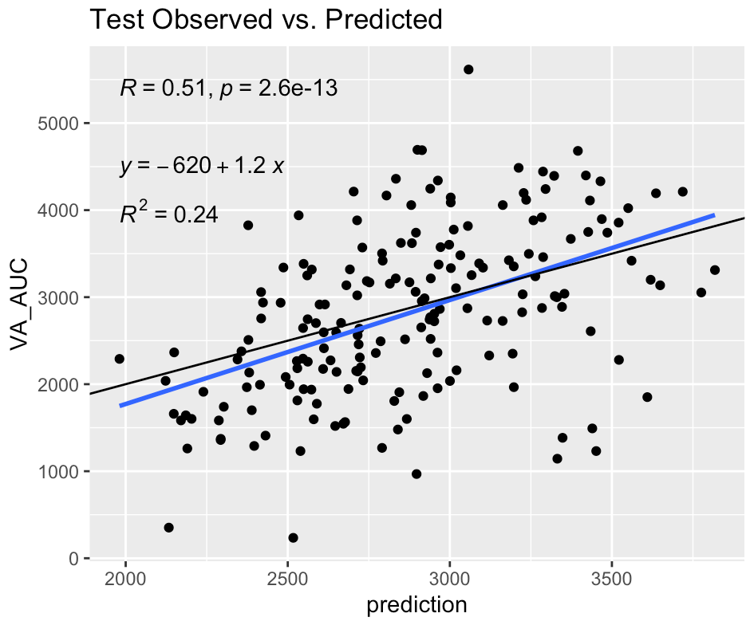


Comparing fit on training and testing data
RMSE for training data
RMSE for testing data

Slide 12
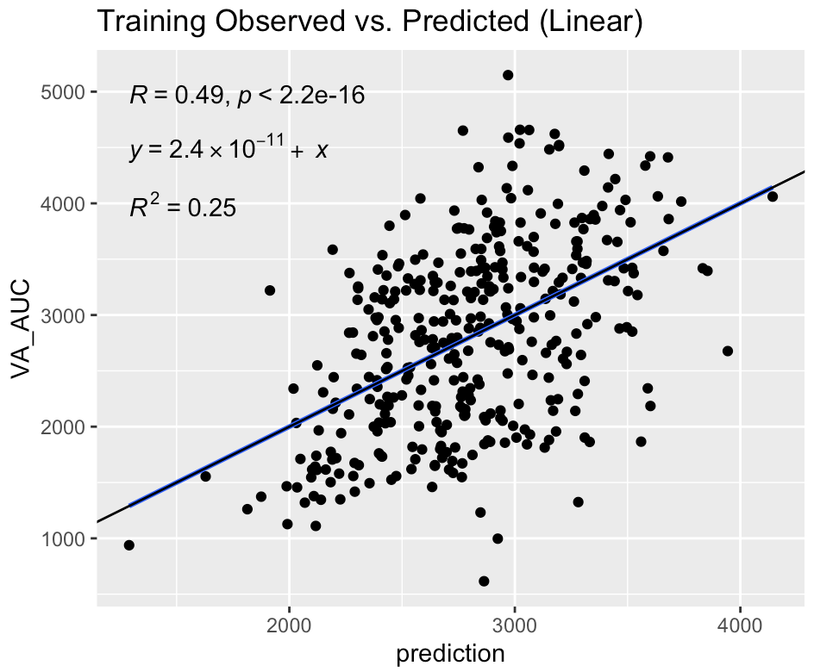
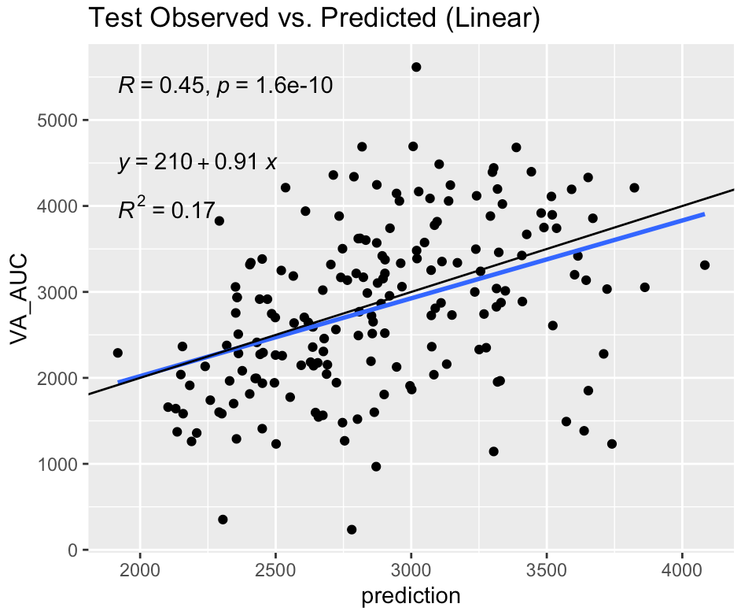
Validating Linear Model

Slide 13
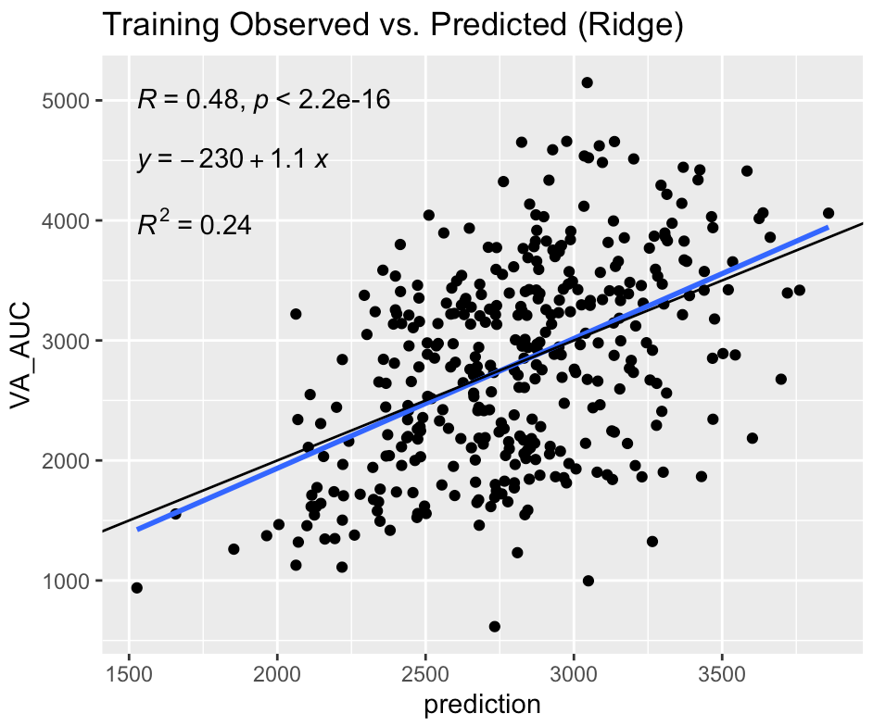
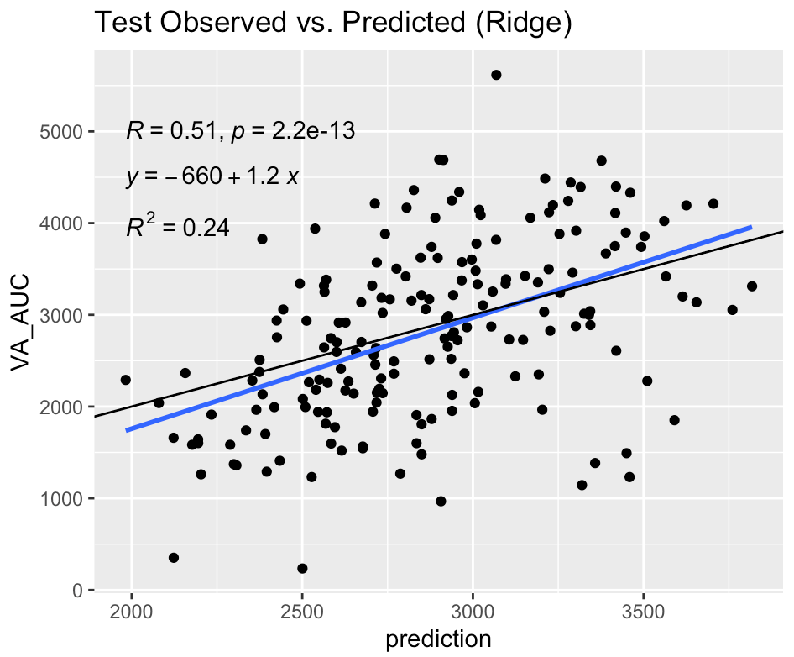
Validating Ridge Model

Slide 14
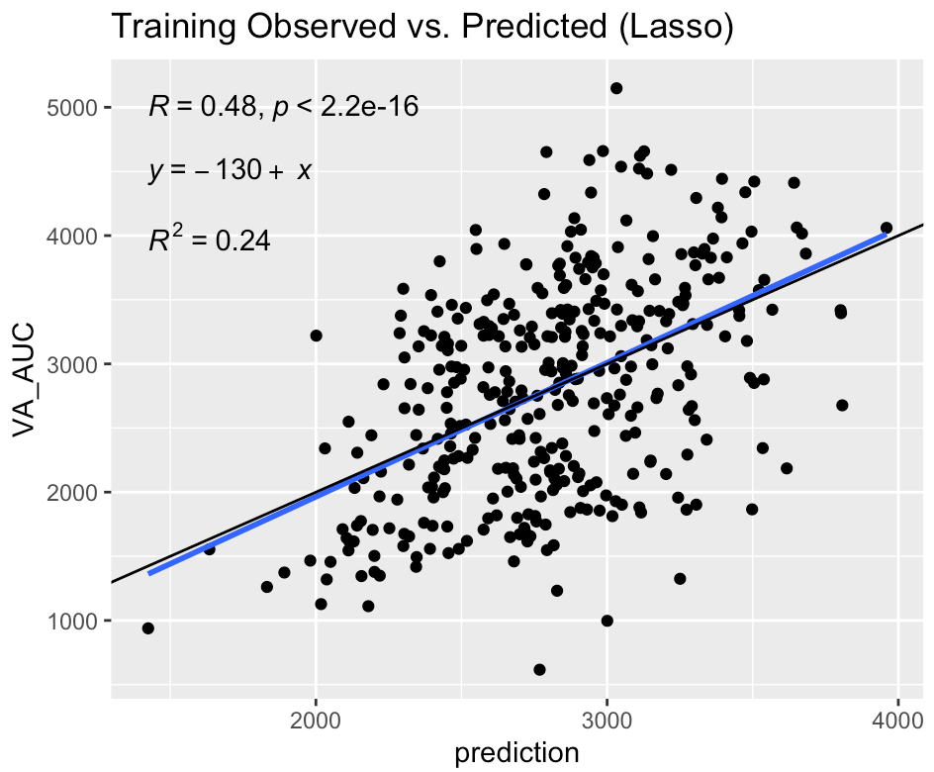
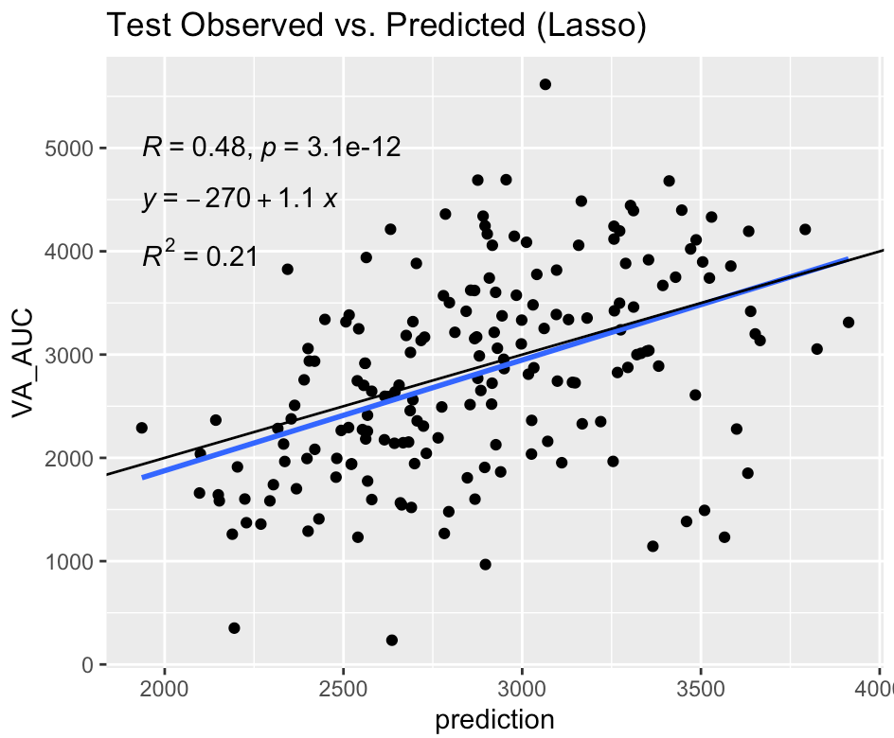
Validating Lasso Model

